Slide 1

PRIMED 4 GOLD™
PARTNERSHIP DECK
EXPERIENCES & OPPORTUNITIES
A division of Prime Athletics Corporation built to create access, development, relationships, and lasting impact through meaningful experiences.
THE ROAD STARTS SOMEWHERE
ONE EXPERIENCE CAN IMPACT WHAT COMES NEXT.
You never know which moment will change everything.
EARN THE RIGHT TO WIN — JAMES PECKHAM

Slide 2
WHY PARTNER WITH P4G
Build What Comes Next, Together
P4G partnerships help create meaningful experiences for athletes, families, coaches, schools, clubs, businesses, and communities.
ACCESS
IMPACT
VISIBILITY
Support pathways that connect people to experiences, instructors, relationships, and opportunity.
Invest in programs that can inspire confidence, development, discipline, and long-term growth.
Align your brand with a respected sports, wellness, and entertainment ecosystem.
PRIMED 4 GOLD™ • EXPERIENCES & OPPORTUNITIES
A Division of Prime Athletics Corporation
EARN THE RIGHT TO WIN — JAMES PECKHAM

Slide 3
THE P4G PHILOSOPHY
The Roadmap to G.O.L.D.
G.O.L.D. is not just the destination. It is the process of getting there.
G
GOALS
O
OPPORTUNITY
L
LEARNING
D
DEVELOPMENT
Define where you want to go.
Put yourself in position.
Take something from the experience.
Become better because of it.
GOALS → OPPORTUNITY → LEARNING → DEVELOPMENT
PRIMED 4 GOLD™ • EXPERIENCES & OPPORTUNITIES
A Division of Prime Athletics Corporation
EARN THE RIGHT TO WIN — JAMES PECKHAM

Slide 4
EXPERIENCES & OPPORTUNITIES
What P4G Creates
The division is built to support different formats while maintaining one purpose: meaningful development and impact.
Elite wrestling camps and clinics
MMA / combat-sports experiences
Leadership and mindset seminars
Parent and athlete workshops
Performance and wellness programming
Special showcases and community experiences
THE EVENT ENDS.
THE IMPACT SHOULDN’T.
P4G creates environments where people can learn, connect, develop, and carry something meaningful forward.
PRIMED 4 GOLD™ • EXPERIENCES & OPPORTUNITIES
A Division of Prime Athletics Corporation
EARN THE RIGHT TO WIN — JAMES PECKHAM

Slide 5
WHY PRIMED 4 GOLD
The Golden Difference
The P4G experience is designed around more than attendance. It is built around what people take away.
ACCESS
INTERACTION
DEVELOPMENT
Learn from accomplished people with meaningful experience.
Ask questions and build real connections.
Build skills, confidence, and character that last.
PERSONAL ATTENTION
THE EXPERIENCE
OPPORTUNITY
Structure experiences to preserve meaningful support.
Create memorable moments worth being part of.
Open doors to what comes next.
Every partnership should help create access, respect, development, and a lasting positive impression.
PRIMED 4 GOLD™ • EXPERIENCES & OPPORTUNITIES
A Division of Prime Athletics Corporation
EARN THE RIGHT TO WIN — JAMES PECKHAM

Slide 6
PARTNERSHIP OPPORTUNITIES
Flexible Ways to Partner
P4G can support one-time event sponsorship, multi-experience collaboration, community investment, and participant opportunity sponsorship.
PRESENTING PARTNER
SUPPORTING PARTNER
COMMUNITY PARTNER
Exclusive presenting status
Premium logo visibility
Speaking / activation opportunities
Year-round collaboration
Logo placement on select events
Social + digital recognition
On-site engagement
Program support recognition
Local engagement and support
Shared mission + impact
Community program participation
Recognition where appropriate
Additional path: P4G Opportunity Sponsor / Donor
PRIMED 4 GOLD™ • EXPERIENCES & OPPORTUNITIES
A Division of Prime Athletics Corporation
EARN THE RIGHT TO WIN — JAMES PECKHAM

Slide 7
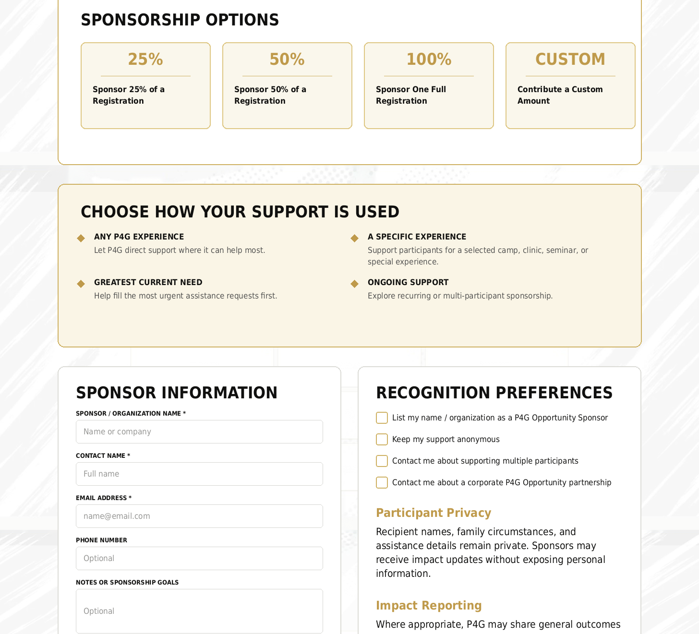
OPPORTUNITY PROGRAM
Create Access Without Exposing Hardship
Sponsors help make P4G experiences more accessible while recipient identities and circumstances remain private.
Sponsor Options
Sponsor 25% of a registration
Sponsor 50% of a registration
Sponsor one full registration
Contribute a custom amount
Direct support to a specific event or greatest need
We celebrate the opportunity—not the hardship.
PRIMED 4 GOLD™ • EXPERIENCES & OPPORTUNITIES
A Division of Prime Athletics Corporation
EARN THE RIGHT TO WIN — JAMES PECKHAM

Slide 8
BRAND VISIBILITY & ACTIVATION
Where Partners Show Up
Partnership visibility should be meaningful, tasteful, and connected to the actual experience.
EVENT PRESENCE
On-site signage, welcome mentions, activation tables, participant materials, and host acknowledgments.
DIGITAL VISIBILITY
Website listings, event pages, approved social content, email features, and post-event recaps.
COMMUNITY IMPACT
Opportunity sponsorship, local access, youth participation, and mission-driven community support.
PRIMED 4 GOLD™ • EXPERIENCES & OPPORTUNITIES
A Division of Prime Athletics Corporation
EARN THE RIGHT TO WIN — JAMES PECKHAM

Slide 9
WHO WE REACH
Audience & Community
P4G reaches people who care about growth, discipline, performance, family, opportunity, and meaningful development.
ATHLETES
PARENTS & FAMILIES
COACHES & CLUBS
SCHOOLS & ORGANIZATIONS
COMMUNITY PARTNERS
SPONSORS & LOCAL BUSINESSES
P4G is broad enough for multiple experience categories, but focused enough to maintain a consistent standard of excellence.
PRIMED 4 GOLD™ • EXPERIENCES & OPPORTUNITIES
A Division of Prime Athletics Corporation
EARN THE RIGHT TO WIN — JAMES PECKHAM

Slide 10
HOW WE WORK
Partnership Process
A clean process keeps the experience professional, organized, and aligned with the partner’s goals.
01
02
03
04
CONVERSATION
PLAN
ACTIVATE
REPORT
Understand goals, audience, region, and desired impact.
Define the partnership type, visibility, timeline, and experience structure.
Promote, coordinate, execute, and support the event or program.
Share outcomes, impact, media, and future opportunities.
The goal: create an experience that feels organized, valuable, authentic, and worth repeating.
PRIMED 4 GOLD™ • EXPERIENCES & OPPORTUNITIES
A Division of Prime Athletics Corporation
EARN THE RIGHT TO WIN — JAMES PECKHAM

Slide 11
MEASUREMENT
What We Track
Partnership impact should be measurable without losing the human story behind the experience.
Registrations and attendance
Audience demographics where available
Engagement with event pages and CTAs
Social and email performance
Sponsor visibility delivered
Participant feedback and testimonials
Opportunity Program support delivered
Future lead and partnership opportunities
IMPACT REPORT
After major partnerships, P4G can provide a simple recap covering outcomes, visibility, participant response, and next steps.
PRIMED 4 GOLD™ • EXPERIENCES & OPPORTUNITIES
A Division of Prime Athletics Corporation
EARN THE RIGHT TO WIN — JAMES PECKHAM

Slide 12
PRIMED 4 GOLD™
EXPERIENCES & OPPORTUNITIES
Let’s start a P4G partnership conversation.
Together, we can create experiences that build people, strengthen communities, and leave a lasting impact.
HOST • COLLABORATE • CREATE
EARN THE RIGHT TO WIN.
— JAMES PECKHAM
info@primeathletics.com

